Slide 1
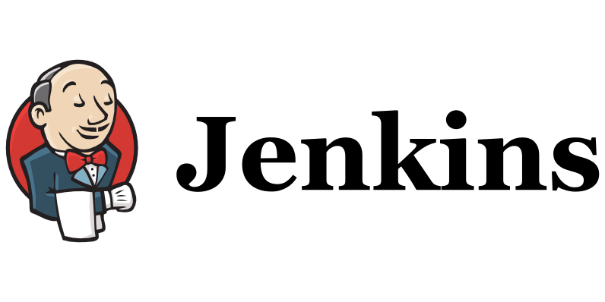

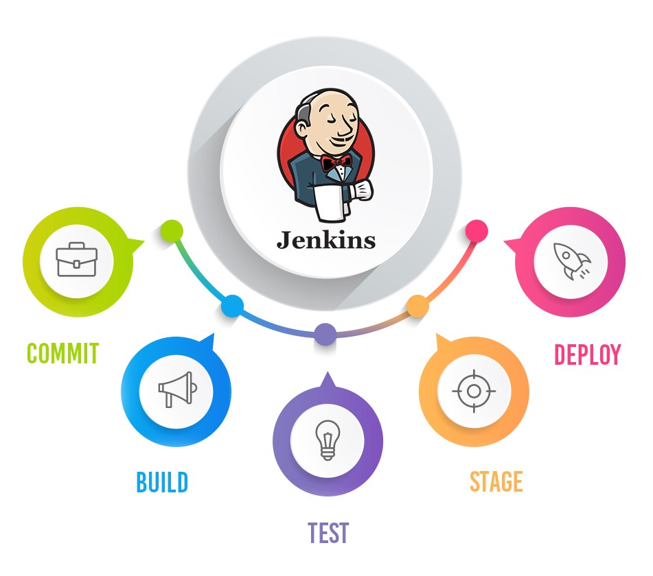
Jenkins Mastery for Software Tester
Pramod Dutta
Install jenkins on windows, Mac and Ubuntu

Slide 2
Agenda
Install Jenkins
Running a Maven Project Selenium Hello World
Understand FreeStyle Job

Slide 3

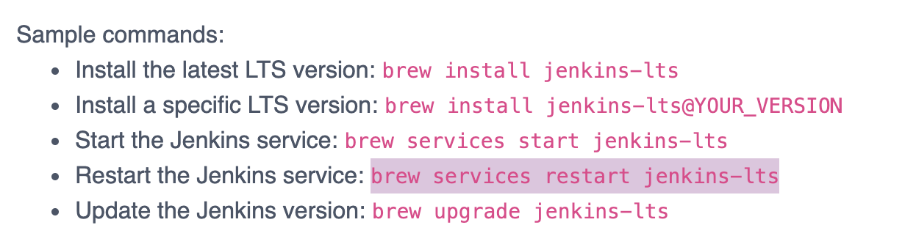
Install Jenkins
https://www.jenkins.io/download/

Slide 4
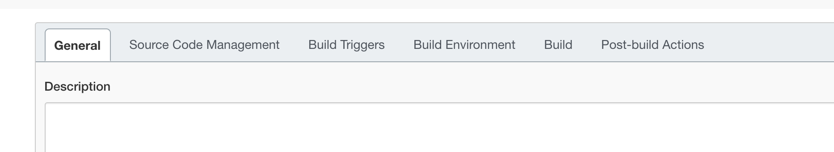
What is FreeStyle Job in Jenkins
Freestyle means improvised or unrestricted.
According to the official Jenkins wiki, a freestyle project is a typical build job or task. This could be as simple as running tests, building or packaging an application, sending a report, or even running some commands. Before any tests are run, data is collated.
Jenkins Freestyle Project is a repeatable build job, script, or pipeline that contains steps and post-build actions

Slide 5
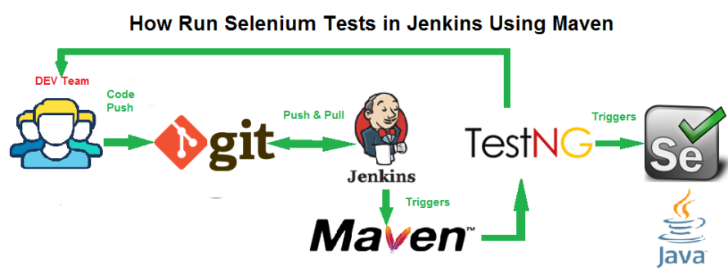
Run Selenium Test on Jenkins

Slide 6

Lets See Jenkins Job Demo
Demo Jenkins job

